Slide 1
Skull-stripping Quality Tool
Team 03 - Michael Harris, Joey Binz, and Jacob Schechter
• 04.17.2023

Slide 2
Overview
Background
3D CNN Model Overviews
Data Preprocessing
Training Strategies
Results
Limitations
Future Improvements
Questions

Slide 3
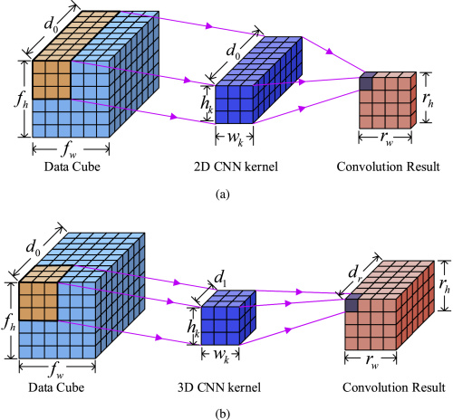
Background - 3D CNN
CNN (Convolutional Neural Network) - capable of reducing an image to key features for easier classification
3D CNN - utilizes a 3-dimensional filter for convolutions enabling the kernel to slide in 3 directions for volumetric data (i.e. 3D MRI scans)
Provides scalability within the spatial direction without the need for additional preprocessing or hyperparameter adjustment
Capable of capturing adjacent voxels which allows for more effective analysis of spatial patterns within the 3D structure
[2] - 3D CNN v.s. 2D CNN

Slide 4
Background - 3D CNN Layers
Model Layers:
Input - receives the volumetric data (i.e. 3D MRI scans)
Convolutional - applies a 3D kernel to the input data for performing operations on spatial locations, producing a 3D feature map
Max Pooling - reduces the dimensionality of the feature map of by combining each local cluster of neurons in the feature map
ReLU (Rectified Linear Unit) - activation function applied to the feature map to introduce non-linearity
Leaky ReLU - prevents “dying ReLU” by allowing for small negative values when (input < 0)
Dropout - prevents overfitting by randomly setting input units to 0 at an established frequency rate at each step in training
Fully Connected Output - produces the final classification output through combining learned features from previous layers

Slide 5
Model Overview:
Model 1:
Goal: Pass brain scans through a 3D CNN to classify an image as being stripped or not and to determine whether there is any brain loss.
Simplified bare bones 3D CNN which uses 3 convolutional layers of increasing depth
Kernel size of 3, and padding of 1
Max pooling layers used after each convolution & relu activation function
Fully connected output layer 2 levels deep
Dropout layer at p = 0.5 to help with generalization
Outputs a 3 dimensional prediction array

Slide 6
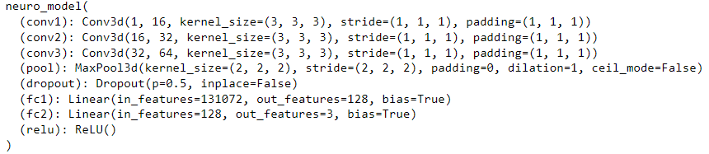
Model Overview:
Model 1:
Pytorch Model Summary:

Slide 7

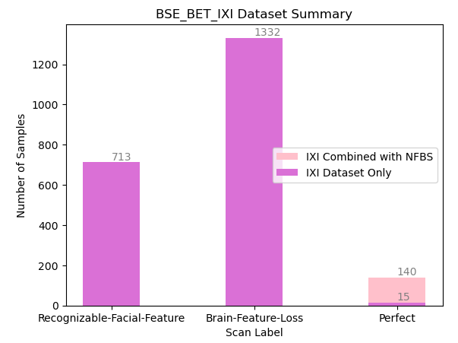
Data Preprocessing:
Model 1:
Trained on a nifti dataset of 2,185 labeled brain scans
1,332 missing data, 713 with recognizable facial features, and 140 perfect scans
Pulled nifti data from BSE_BET_IXI data and a publicly available dataset of perfect brain scans with no facial features or data loss compiled from various computational neuroimaging labs
An additional 125 perfect brain scans were added from a publicly available dataset created by the Kline Institute for Psychiatric Research

Slide 8
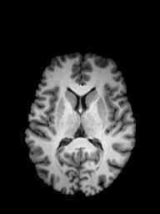
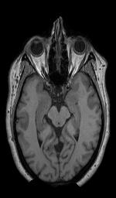
Data Preprocessing:
Model 1:
Before each file was added to the DataLoader, it was normalized and resized to be 64x128x128.
The data was comprised of three different classes: stripped w/ brain loss, not-stripped w/ no brain loss, and stripped w/ no brain loss.
Processed with a batch size of 4, with a 70/30 train/test split
70% (or 30% for testing data) of each type of label was taken to keep data as even as possible

Slide 9
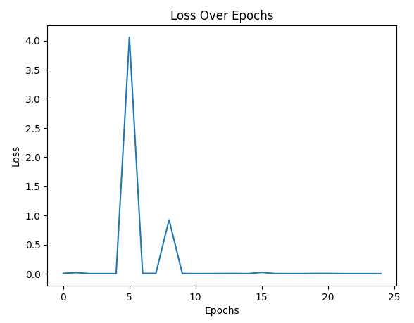
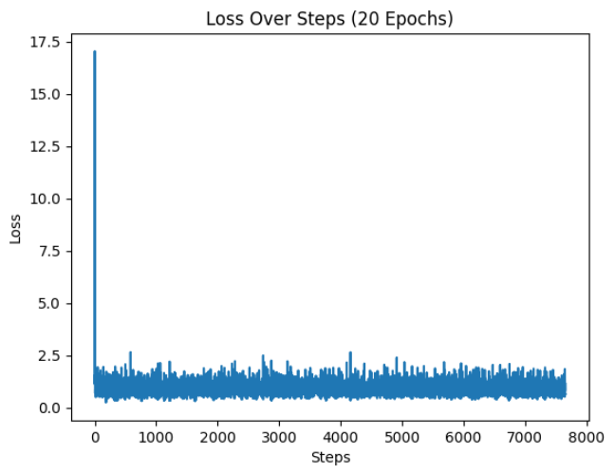
Results
98% accuracy run
Model 1:
Cross-Validated Accuracy of 98% test & 99% training trained over 25 epochs (likely relatively overfit to the small dataset)
Less patterns for the model to learn
Cross-Validated Accuracy of 89% test (90% training) when trained over 5 epochs to help reduce overfitting
Occasionally reported accuracy of 60% after 20 epoch training
Due to bad initial weights of the model, weight initialization fixed this issue
Mostly mis-classifying cases of recognizable facial Features as data loss
60% accuracy run
(before weight initialization)

Slide 10
Model Overview:
Model 2:
Goal: Pass brain scans through a 3D CNN to classify an image as being stripped or not and to determine whether there is any brain loss.
3-layer 3D CNN that uses Leaky Relu and max pooling after each convolution.
Kernel size of 3, and padding of 1
Max pooling layers used after each convolution & relu activation function
Fully connected output layer 2 levels deep
Dropout layer at p = 0.5 to help with generalization
Outputs a 3 dimensional prediction array

Slide 11
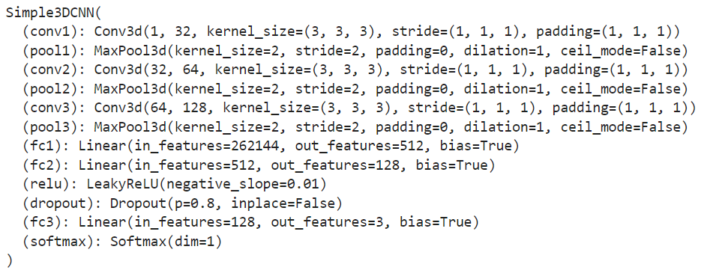
Model Overview:
Model 2:

Slide 12
Data Preprocessing:
Model 2:
Trained on a mixed dataset of BSE_BET data and from a third-party dataset that had a total of 350 scans of perfectly stripped brains.
Before each scan was added to the data loader, it was normalized and resized to be 64x128x128.
The data was comprised of three different classes: stripped w/ brain loss, not-stripped w/ no brain loss, and stripped w/ no brain loss.
Used around 750 different scans in the training set and packed them into a Pytorch data loader with a batch size of 2. The other 300 scans were put into the validation set with the same parameters.

Slide 13
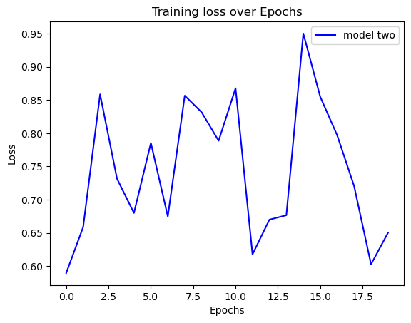
Results
Model 2:
Accuracy varied between 97.6% and 33% after 20 epochs in the amp_fit training function.
Note: This result varied between every training session. I believe that this might have been due to a need for weight initialization.
After adding weight initialization using the xavier_uniform, the accuracy of the model consistently tested higher than before.

Slide 14
Training Strategies:
fit(model):
Simplified training loop using Adam optimizer and cross entropy loss.
Constant learning rate of 0.001
amp_fit(model):
This training loop used automatic mixed precision and linear learning rate decay to help the model converge more efficiently and effectively.

Slide 15
Limitations
Small Dataset - results in poor approximation and will result in a high variability in estimation of model performance (i.e. poor training)
High Computational Complexity - 3D CNN’s are inherently resource intensive with regard to processing power and memory usage
Limited Prior Experience - limited exposure and experience working with deep learning

Slide 16
Future Improvements
Building a larger dataset to train & test on
Particularly having an even amount of perfect/data loss/facial feature scans
Adding further optimizations to the training loop
Slightly rotating the nii models each run to improve generalization
Improving the model’s design
Batch Normalization
Experimenting more with hyper parameters
Other advanced techniques

Slide 17
References
[1] S. Sara, B. Samir, H. Ahmed and C. Bouchaib, "A robust comparative study of five brain extraction algorithms (BET; BSE; McStrip; SPM2; TMBE)," 2014 Second World Conference on Complex Systems (WCCS), Agadir, Morocco, 2014, pp. 632-636, doi: 10.1109/ICoCS.2014.7060986.
[2] Linxia Zhang, Edmund Y. Lam, and Jun Ke, "Temporal compressive imaging reconstruction based on a 3D-CNN network," Opt. Express 30, 3577-3591 (2022)

Slide 18
Questions?

